Slide 1
Weather Policies for Games
Air Quality, Heat, Cold & Lightning
NCYSA

Slide 2
Reschedules
  Teams can communicate requests to attempt to reschedule a game due to weather related issues with the home club.
  NCYSA will not add a “11th” week to the season, as some clubs do not have fields for this .
  Teams should not be forced to play 2 games in one day to makeup a game.
  In the event a game is not able to be re-scheduled and a determination for standings is necessary, NCYSA policy of applying a points per game played to determine a division winner will come into to effect.

Slide 3
Air Quality
Levels of Health Concern | Meaning | Colors | PMI Level | Impact Games | Impact Practice
Good | Air quality is considered satisfactory. Air pollution poses little or no risk | Green | 0-50 | None | None
Moderate | Air quality is acceptable; however, for some pollutants there may be a moderate health concern for a very small number of people who are unusually sensitive to air pollution. | Yellow | 51-101 | Increase water breaks | Increase water breaks. Shortened practices. Cancel at Club discretion.
Unhealthy for Sensitive Groups | People with heart and lung disease, older adults, and children are at greater risk from air pollution. | Orange | 102-150 | Play; two (2) hydration breaks each half. | Cancel at Club discretion.
Unhealthy | Everyone may begin to experience health effects; members of sensitive groups may experience more serious health effects | Red | 151 + | Games Cancelled | Cancel.
Closest monitoring stations to fields will be used to assess conditions (may as required be a combination)
  website to utilize https://fire.airnow.gov/?lat=48.01497&lng=-122.06402&zoom=8
  Each Club will use communication via appropriate means to all their coaches.

Slide 4
Air Quality – Criteria and Sources
For games NCYSA will communicate with Clubs 2 hours prior to game times or as early in the day as possible to determine cancelations using the following guideline:
  Saturdays @ 7am, 9am, 11 am, 1 pm
  Sundays @ 11 am
As required due to shifting weather patterns, some game time decisions may need to be made.
  Safety of players will be taken into consideration.
  If both coaches can not agree on the starting of a game, the home field club will have the final decision on if a game should proceed as scheduled.

Slide 5
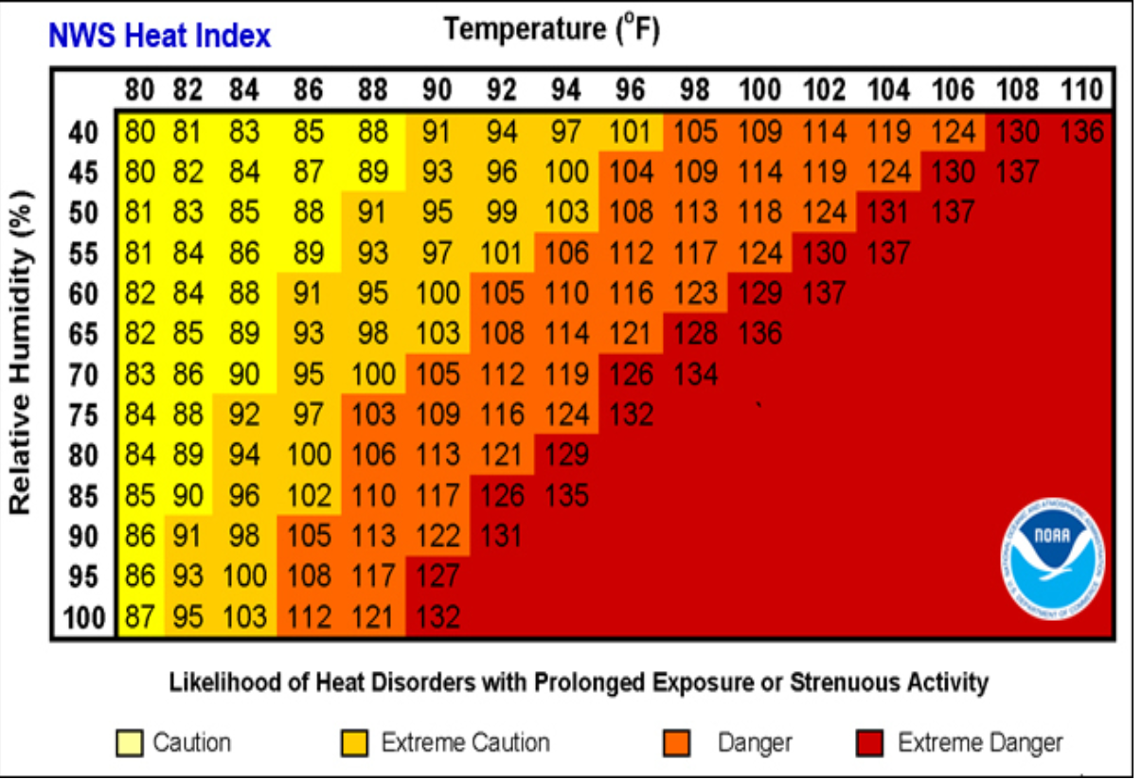
Heat Safety
Websites to reference
National Weather Service – http://www.weather.org
Heat Index Calculator - http://www.wpc.ncep.noaa.gov/html/heatindex.shtml
Weather apps may also provide Heat Index as part of information – yahoo weather, wunderground etc..
Communications will be sent from NCYSA to Club Presidents or designated club representative.
Classification | Heat Index | Effect on the body | Impact
Caution | 80°F - 90°F | Fatigue possible with prolonged exposure and/or physical activity | Increased Water breaks
Extreme Caution | 91°F - 103°F | Heat stroke, heat cramps, or heat exhaustion possible with prolonged exposure and/or physical activity | Increased water breaks, shortened practices. Micros Cancelled
Danger | 104°F or higher | Heat cramps or heat exhaustion likely, and heat stroke possible with prolonged exposure and/or physical activity | All Practices and Games Cancelled

Slide 6
Cold Weather
Guidelines and Injury Prevention/Treatment

Slide 7
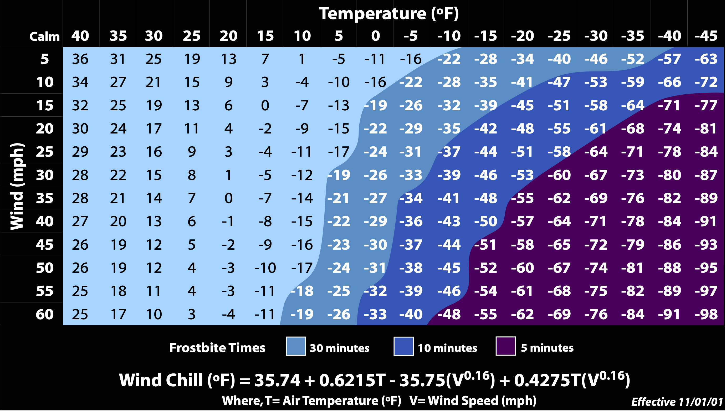
Windchill Chart
The NWS Wind Chill Temperature (WCT) index uses advances in science, technology, and computer modeling to provide an accurate, understandable, and useful formula for calculating the dangers from winter winds and freezing temperatures. The index does the following:
Calculates wind speed at an average height of 5 feet, the typical height of an adult human face, based on readings from the national standard height of 33 feet, which is the typical height of an anemometer
Is based on a human face model
Incorporates heat transfer theory based on heat loss from the body to its surroundings, during cold and breezy/windy days
Lowers the calm wind threshold to 3 mph
Uses a consistent standard for skin tissue resistance
Assumes no impact from the sun, i.e., clear night sky.
Source: https://www.weather.gov/safety/cold-wind-chill-chart

Slide 8
Procedure for Athletic Participation in the COLD
STEPS FOR MONITORING COLD WEATHER:
• Weather should be monitored by designated athletic department personnel (Athletic Trainer if present) and an advisory should be issued to school coaching staff when applicable. Usually by email the day prior to the event warning of the potential, and the day of the event with potential modifications.
• Temperature, wind speed, and wind chill will be monitored.
• Club and Game officials will use a Wind Chill Index Chart
(Chart 1) as a measurement for impending weather situations and adjust outside activities as necessary using the Activity Modification Table 1
  o The Wind Chill Index considers effects of temperature and wind speed (see Chart 1 below) o Keeping in mind that precipitation increases risk dramatically
  o This chart is available at: http://www.nws.noaa.gov/om/winter/windchill.shtml
• Based on information from the National Weather Service, local weather stations and local/on-site Cold Index measurements, determine the risk of potential danger to participants. Issue a warning and implement the practice or game plan for that day to be distributed to all coaches.
Risk | Temp/Wind Chill | Modifications
Low Risk | 30F & below | Outside participation allowed w/appropriate^ clothing
Moderate Risk | 25F & below | Mandate additional protective clothing (hat, gloves, layers) Limit practice time to 60-90 minutes/15 min rewarm Provide re-warming facilities (warm dry environment, fluids, blankets, hot packs)
High Risk | 15F & below | All participants must have appropriate clothing as above Cover all exposed skin (cover helmet ear holes) Outside participation limited to 45 minutes/15min rewarm Provide re-warming facilities (warm dry environment, fluids, blankets, hot packs)
Extreme Risk | 0F or below | Termination of all outside activities * #

Slide 9
Most Common Cold Injury
Frostbite
  Frostbite occurs when tissue freezes. Frostbite can be in exposed skin, e.g. nose, ears, cheeks, but also occurs in hands and feet, because vasoconstriction lowers peripheral tissue temperature significantly. Numbness or a “wooden” feeling is usually the first symptom of frostbite in the hands and feet. With frostbite to exposed facial skin, however, there can be a burning feeling. Freezing of the tissue is often relatively painless. Re-warming is accompanied by sharp, aching pain and persistent loss of light touch sensation.
  The risk of frostbite increases as temperature decreases. With appropriate precautions, the risk of frostbite can be less than five percent when ambient temperature is above 5 degrees F. But increased surveillance of athletes is appropriate when the wind chill falls below minus 18 degrees F, since exposed facial skin then freezes in 30 minutes or less. At these temperatures, consideration should be given to postponing or shortening athletic events. Predetermined school policies bring neutrality to that decision and help the public to anticipate it. Several apps are available for calculation of wind chill.
Hypothermia
  Hypothermia is the core temperature below 35C (95F). In mild hypothermia, an athlete feels cold, shivers, is apathetic and withdrawn, and demonstrates impaired athletic and mental performance. Coaches and athletes must recognize and respond to these early symptoms so as to avoid more severe hypothermia.
  Hypothermia symptoms can be confused with concussion, hypoglycemia or drug use. As core temperature continues to fall, there is confusion, sleepiness, slurred speech and irrational thinking and behavior. Severe hypothermia causes cardiac arrhythmia and arrest. Efforts to resuscitate must persist until re-warming has been achieved.

Slide 10
Prevention of Cold Injury
Risk and Event Management
a. Assess environmental heat loss risk: temperature, wind, rain, solar load, immersion, altitude. Be alert to changes in these factors. Athletes can then be advised to modify clothing or seek shelter. And event managers can consider shortening, moving or cancelling an event. Wind chill temperature index (WCT) integrates temperature and wind to estimate cooling power. The WCT predicts the risk of frostbite to exposed facial skin in a person moving at walking speed. The wind effect of the athlete moving at higher speed (run, ski, bike, skate) is not considered in calculating WCT. The risk of frostbite in the extremities is not predicted by WCT.
b. Assess athletes’ risk factors: exercise demands, fitness, fatigue, health, body fat, hydration and nutritional status.
c. Prepare appropriately: adequate training, clothing, water and food; scheduled clothing changes; provision of shelter and re-warming; planned monitoring of weather conditions and of athlete tolerance of the cold; and action plans to care for athletes, staff and spectators who are having difficulty staying warm.
Clothing: Exercise intensity and ambient temperature determine clothing (insulation) requirements during exercise. Hats are useful, as up to 50 percent of heat loss at rest is from the head. Layering is dressing with an inner layer that wicks perspiration to the outer layers for evaporation, a middle insulating layer that allows moisture transfer, and an outer layer, worn when necessary, to repel wind and rain but capable of transfer of perspiration to the air. Layering allows adjustment in insulation to prevent overheating and sweating, while remaining dry in wet conditions. Glove liners provide wicking and insulation for the hands. Mittens provide significantly more insulation than gloves. Clothing that constricts fingers or toes predisposes to peripheral cold injury. Wet clothing should be removed quickly and replaced, including socks and gloves.
Food and Fluid Intake: Exercise in cold environments increases energy expenditure and fluid loss. Insufficient carbohydrate reserves to maintain core temperature risks cold injury. Dehydration affects neither shivering nor vasoconstriction, but significant loss in circulating volume decreases perfusion. In cold as well as other temperatures, carbohydrate availability and dehydration are limiting factors in performance. Athletes can sustain exercise in cold by ingesting 6-12 percent carbohydrate beverages. Carbohydrate-rich foods are appropriate for prolonged exercise in the cold.

Slide 11
Lightning
Apply the 30-30 rule
  When you see lightning, count the time until you hear thunder. If this time is 30 seconds or less, seek proper shelter. If you can't see the lightning, just hearing the thunder is a good back-up rule. Wait 30 minutes or more after hearing the last thunder before leaving shelter.
  Know and heed warning systems and community rules
  Many communities or park systems have lightning detection and warning systems. Use this information and obey the rules established by the community or park system.
  Know and apply the rules or procedures established by the competition authority
  Minimize the risk of being struck
  Protect the safety of all participants by stopping game activities quickly, so that participants and spectators may retire to a safer place before the lightning threat becomes significant. Remember, if you can hear the thunder, you are within reach of lightning.
Seeking proper shelter
  No place outside is safe near thunderstorms
  The best shelter is a large, fully enclosed, substantially constructed building. A vehicle with a solid metal roof and metal sides is a reasonable second choice.
  If there is no proper shelter, avoid the most dangerous locations:
    Higher elevations; wide open areas, including fields; tall isolated objects, such as trees, poles, or light posts; unprotected open buildings; rain shelters; bus stops; metal fences and metal bleachers.
    If you cannot avoid these locations, crouch down on the balls of your feet, with your head tucked into your chest and your hands over your ears

Slide 12
If someone is hit, remember that all deaths from lightning result from cardiac arrest and stopped breathing CPR and mouth-to-mouth resuscitation, respectively, are the recommended first aid.
Coaches, Referees and/or Parents should become involved in such assistance only if they have proper training. Remain calm. A calm official will often be able to prevent panic by young players. Should a game be suspended due to weather conditions all players, coaches, officials, spectators should seek shelter as appropriate. Play will not be resumed until 30 minutes after the last thunder/lightning sighting. Match officials are required to stay on site (sheltered) as long as the match can still be resumed. If the coaches indicate they will not resume due to weather/time then referees need to indicate that on the match report and contact their assignor. Coaches should notify their appropriate club. It is very likely that there is a match scheduled behind the current one and you may not be able to resume play.
  If a game is delayed for weather, please try and get the game played. Re-scheduling is, as you may well guess, difficult. However, you need to be realistic; the lights may go off, other teams may be scheduled after your game etc. It's possible you may need to shorten the halves; officials, please include the coaches in your discussion, this may resolve some questions about whether to play or not given scheduling concerns. Games are considered played in full after so many minutes have been played, but that is not the decision of the referee. Referees should note on the score sheet at what minute game was suspended and what the score was. The club/association administration will determine whether the game needs to be replayed or the score stands.
Remember that the final decision as to safety lies with the referee once the match has started. If the field conditions are not safe, then don't play the game. Policy regarding weather issues references thunderstorms but works for snow and other conditions as well.

Slide 13
Sources
Air Quality
  www.airnow.gov , www.weather.gov , www.pscleanair.org , www.purpleair.com
Heat
  www.weather.gov, NOAA
Lightning
  US Soccer, Washington Youth Soccer, National Federation of State High School Associations
Cold Weather
  NOAA/NWS – www.weather.gov , National Federation of State High School Associations
  Vermont Principles Assoc., National Athletic Trainers Association

